Slide 1

Doubly-Linked Lists
© 2013 Goodrich, Tamassia, Goldwasser
Doubly-Linked Lists
Notes:
Sequences

Slide 2




Doubly Linked List
A doubly linked list provides a natural implementation of the Node List ADT
A Node stores:
  element
  link to the previous node
  link to the next node
Special trailer and header nodes
prev
next
elem
node
header
nodes/positions
trailer
elements
© 2013 Goodrich, Tamassia, Goldwasser
Doubly-Linked Lists
Notes:
The use of sentinels is to make sure that each real node has a predecessor and a successor node, removing the edge case when deleting the last node or adding the first node into a list
Sequences

Slide 3
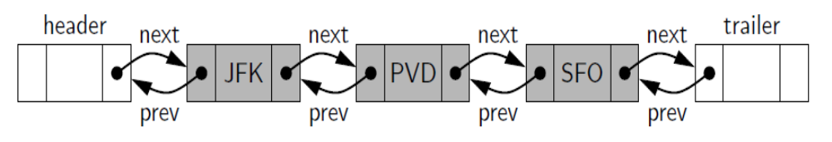
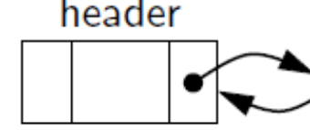
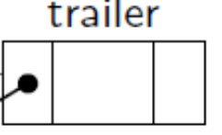
Header and Trailer Sentinels
When Empty:
© 2013 Goodrich, Tamassia, Goldwasser
Doubly-Linked Lists
Notes:
Sequences

Slide 4
Node Class for Double Link List
class _Node:
”””Lightweight, nonpublic class for storing a doubly linked node.”””
__slots__= _element , _prev , _next # streamline memory
def __init__(self, element, prev, next): # initialize node’s fields
self._element = element # user’s element
self._prev = prev # previous node reference
self._next = next # next node reference
© 2013 Goodrich, Tamassia, Goldwasser
Doubly-Linked Lists

Slide 5
Insertion
Insert a new node, q, between p and its successor.
p
A
B
C
p
q = Node(‘X’, prev=p, next=p._next)
A
B
q
C
X
p._next = q
q._next._prev = q
size += 1
p
q
A
B
X
C
© 2013 Goodrich, Tamassia, Goldwasser
Doubly-Linked Lists
Notes:
q._prev = p
q._next = p._next
p._next._prev = q
p._next = q
Sequences

Slide 6
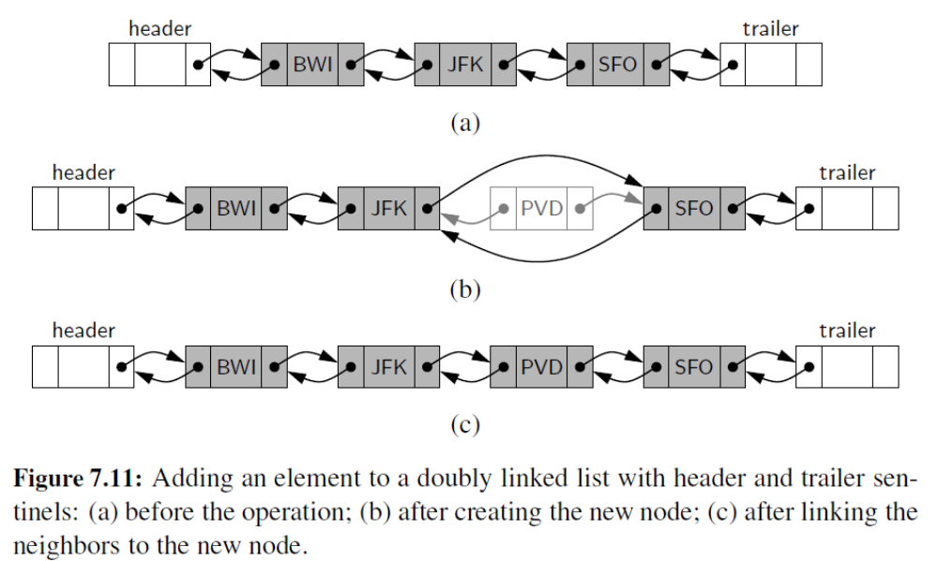

More Insertions Examples
© 2013 Goodrich, Tamassia, Goldwasser
Doubly-Linked Lists

Slide 7
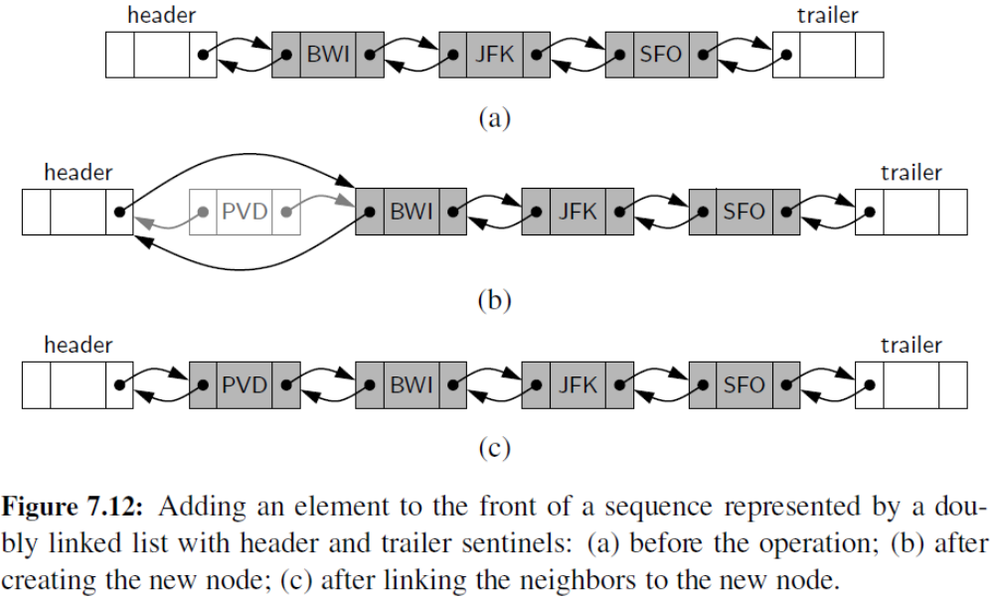
Insert at front
tmp
tmp = Node(‘PVD’, prev=header, next=header._next)
tmp._next._prev = tmp header._next = tmp size += 1
© 2013 Goodrich, Tamassia, Goldwasser
Doubly-Linked Lists

Slide 8
Deletion
Remove a node, p, from a doubly-linked list.
p
A
B
C
D
A
B
C
p
predecessor = p._prev
successor = p._next
predecessor._next = successor
successor._prev = predecessor
p._prev = None
p._next = None
p._element = None
size -= 1
D
A
B
C
© 2013 Goodrich, Tamassia, Goldwasser
Doubly-Linked Lists

Slide 9
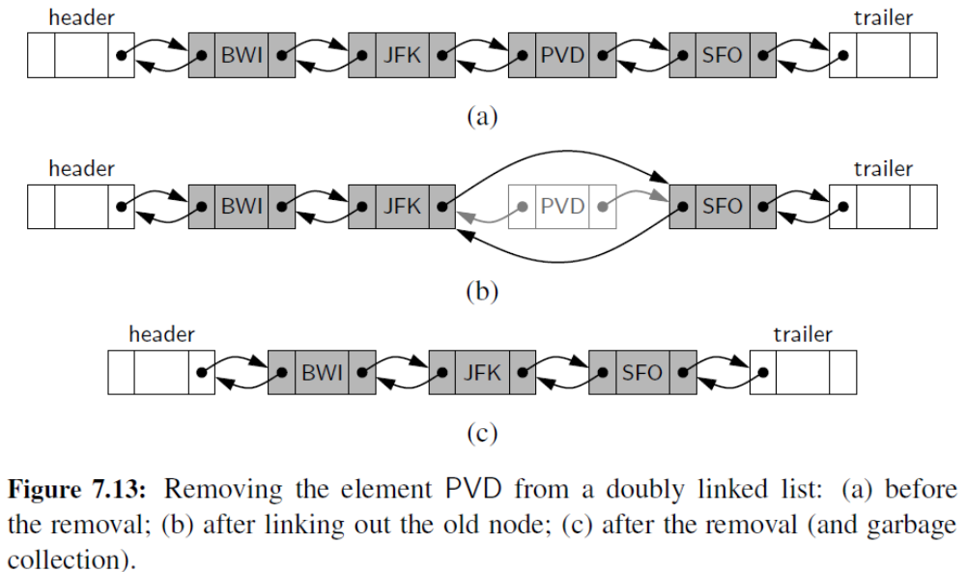
More Deletions
© 2013 Goodrich, Tamassia, Goldwasser
Doubly-Linked Lists

Slide 10
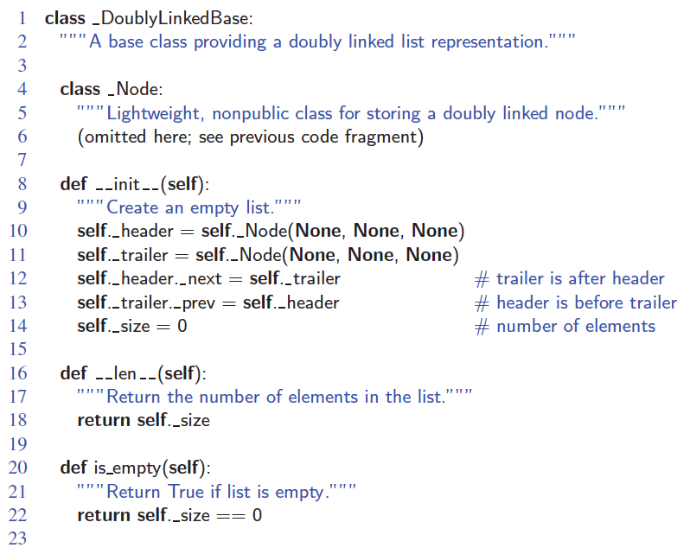
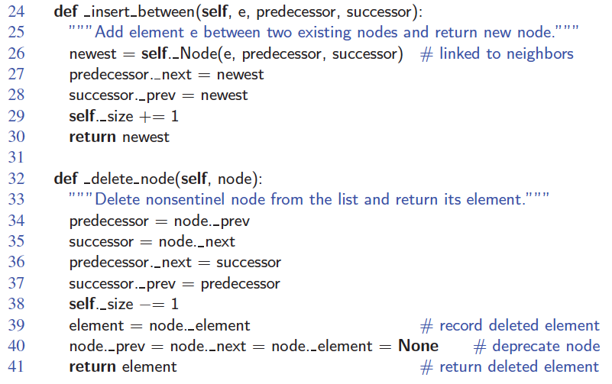
Doubly-Linked List in Python
© 2013 Goodrich, Tamassia, Goldwasser
Doubly-Linked Lists

Slide 11
Performance
In a doubly linked list
  The space used by a list with n elements is O(n)
  The space used by each position of the list is O(1)
  All the standard operations of a list run in O(1) time
© 2013 Goodrich, Tamassia, Goldwasser
Doubly-Linked Lists

